Slide 1
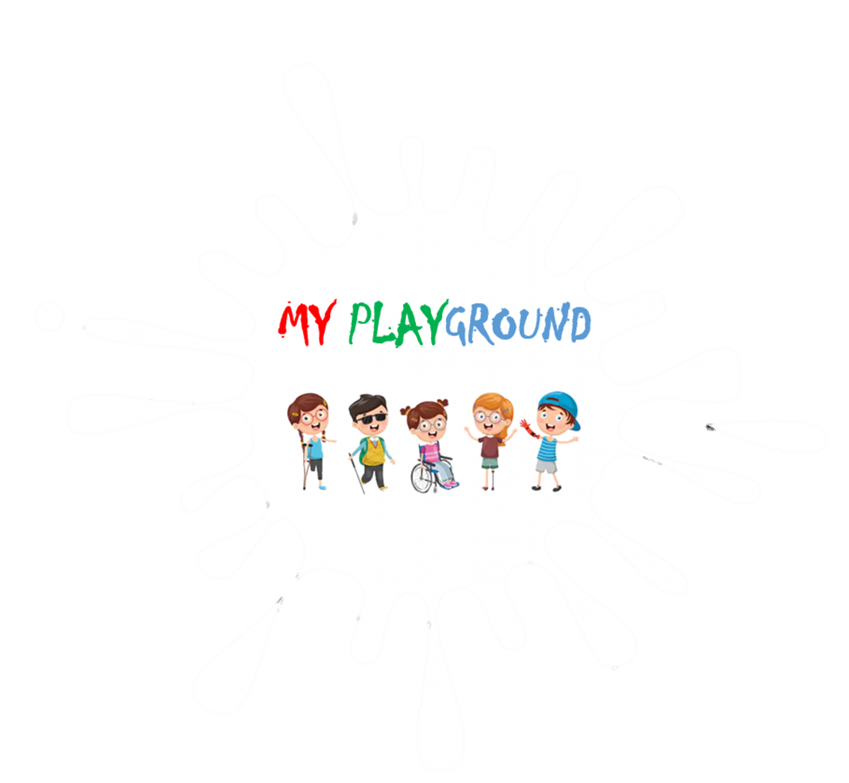

Slide 1
My Playground
El Paso Strong Hackathon
02•02•2020

Slide 2
Slide 7
PROJECT OVERVIEW
ADA PARKS
PHASE 1
RESEARCH AND DEVELOPMENT OF THE APP
PHASE 2
STATISTICS & STRATEGY
PHASE 3
COMMERCIAL VIABILITY

Slide 3

Slide 5
HOW MANY AMERICAN DISBILITIES ACT (ADA) COMPLIANT PARKS ARE THERE IN EL PASO?

Slide 4
Slide 7
CORRECT
ALL OF THEM ARE ADA COMPLIANT (OR AT LEAST THEY SHOULD BE)

Slide 5
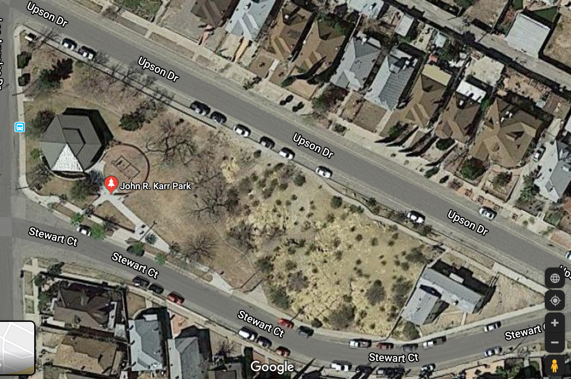
Slide 6

Slide 6
Slide 5
NOW,
DO THOSE PARKS ALSO COMPLY WITH ADA PLAYGROUNDS?

Slide 7
Slide 7
WELL, LET’S SEE IT FOR OURSELVES

Slide 8
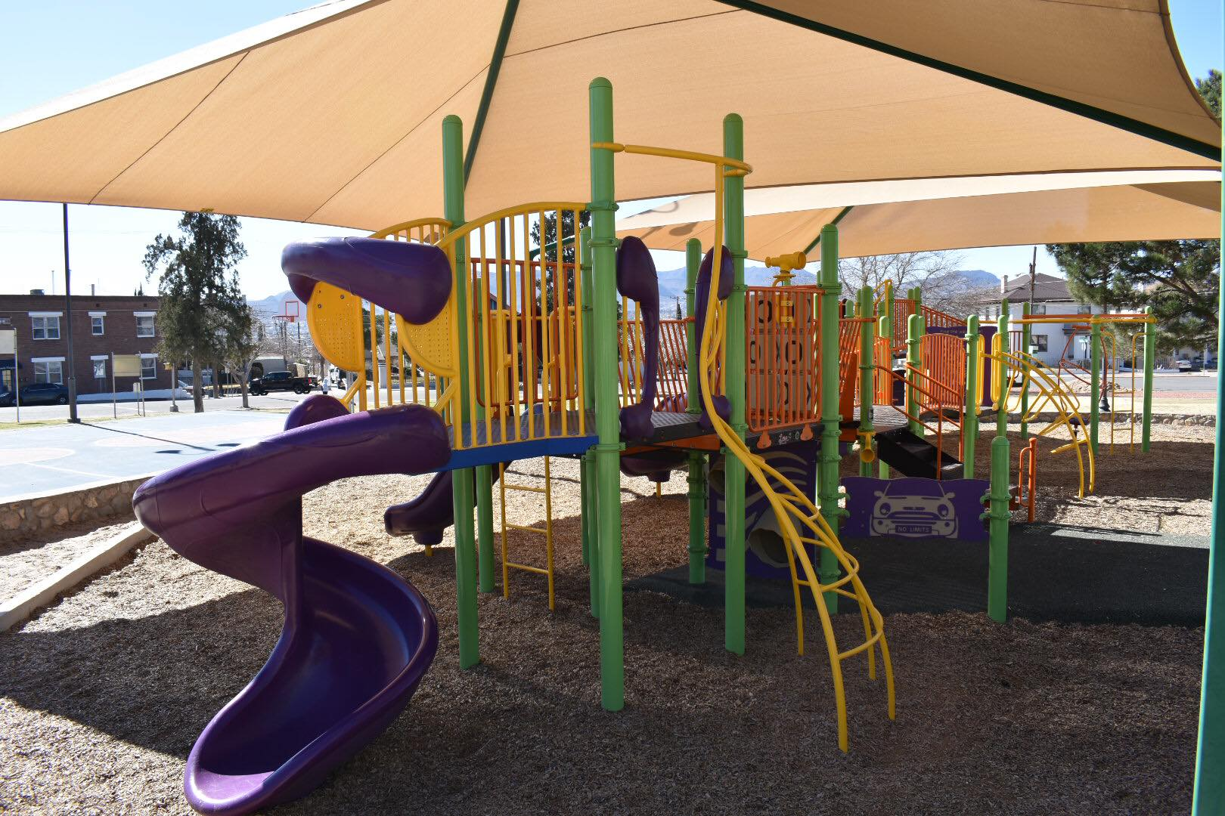
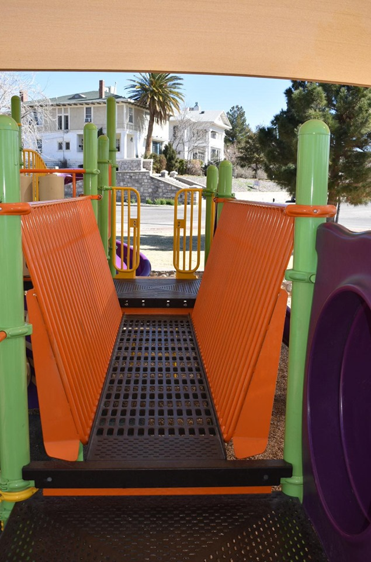
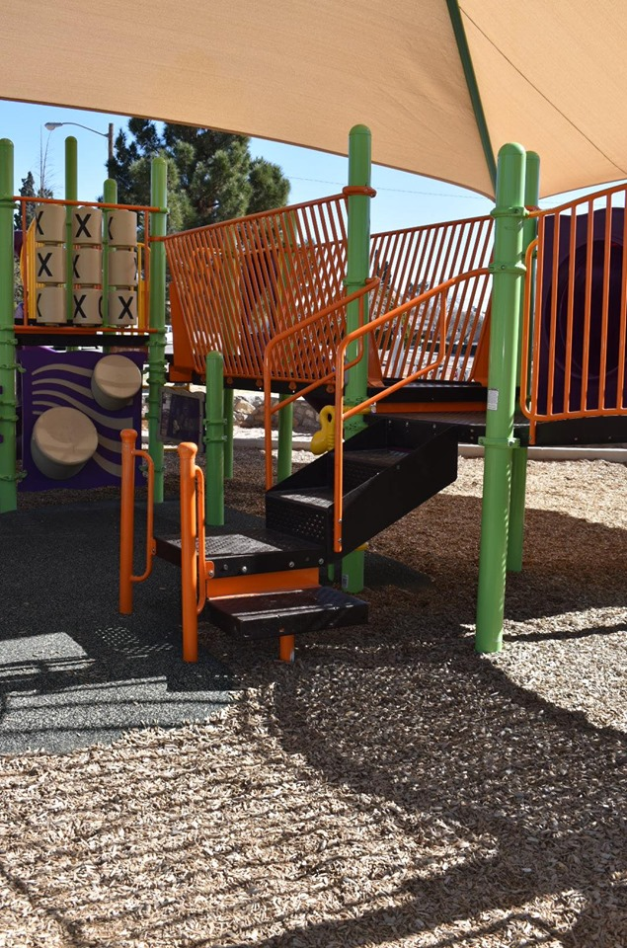
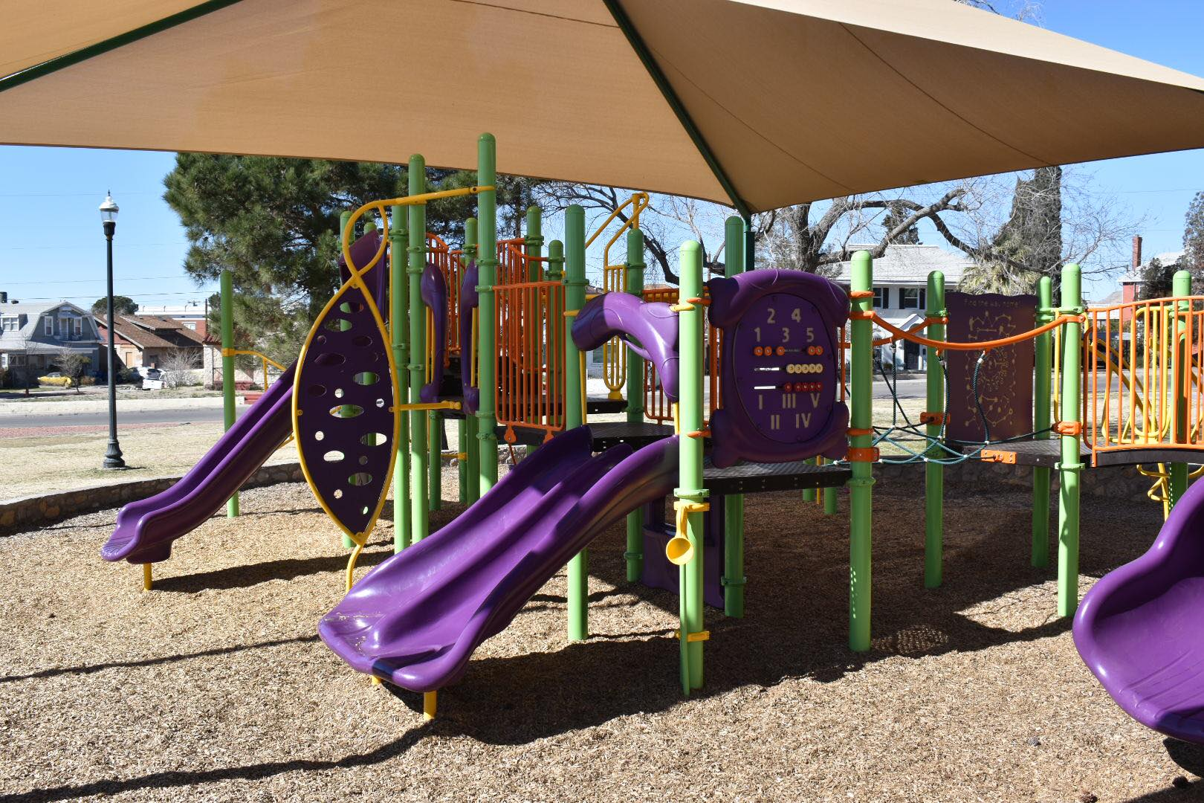
Slide 6
MUNDY PARK
500 Porfirio Diaz St, El Paso, TX 79902

Slide 9
Slide 7
HOWEVER

Slide 10
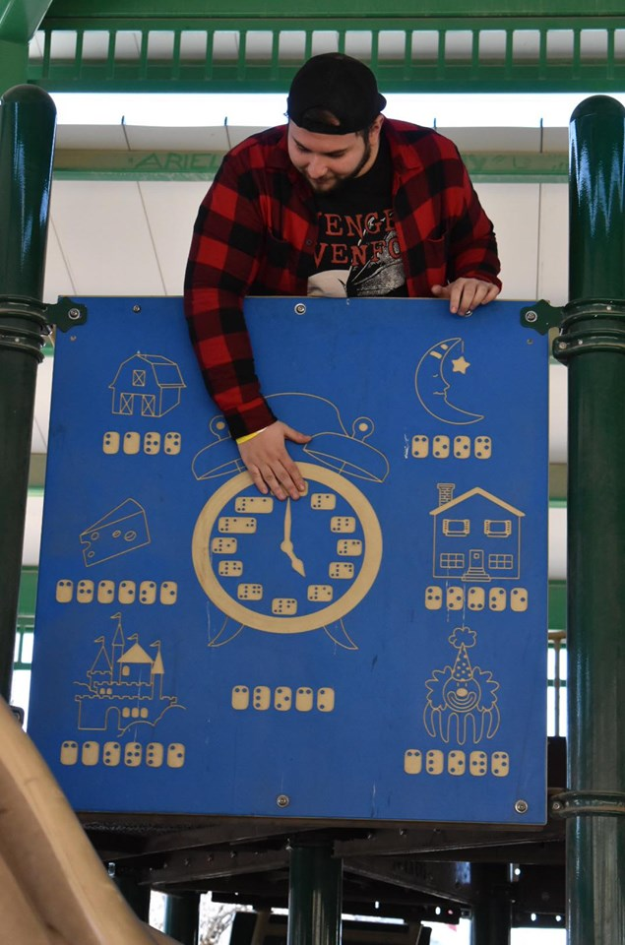
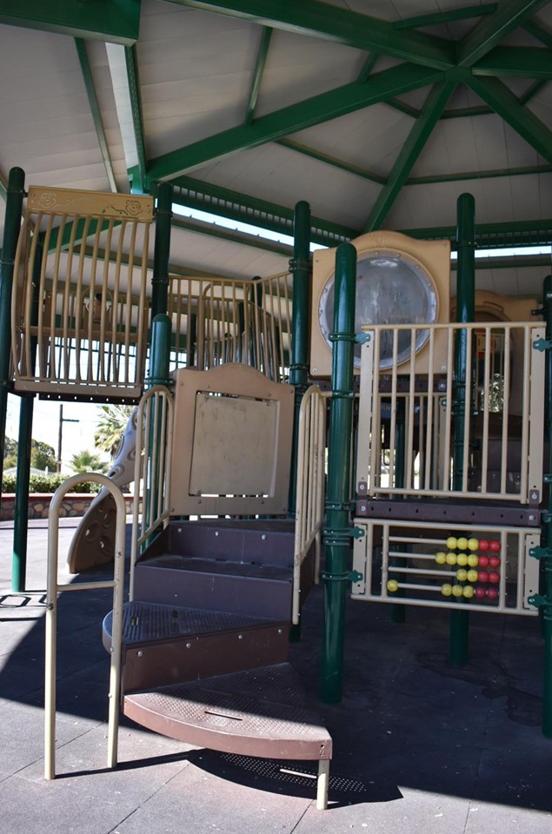
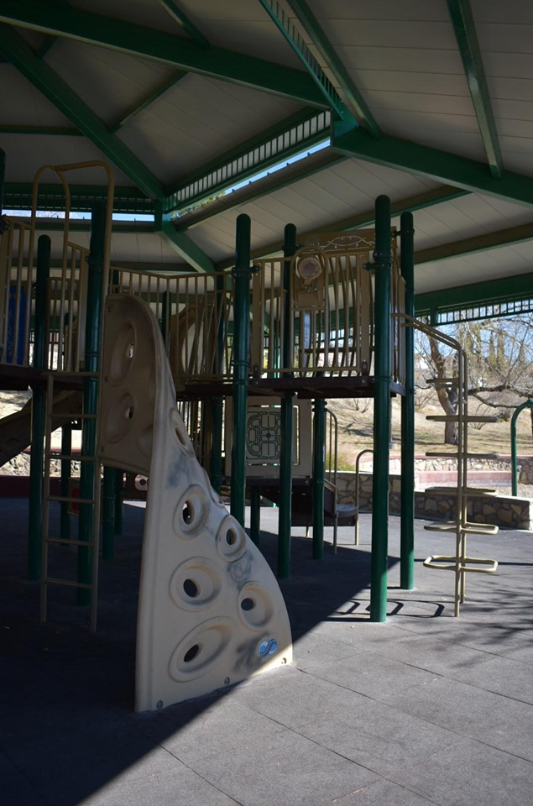
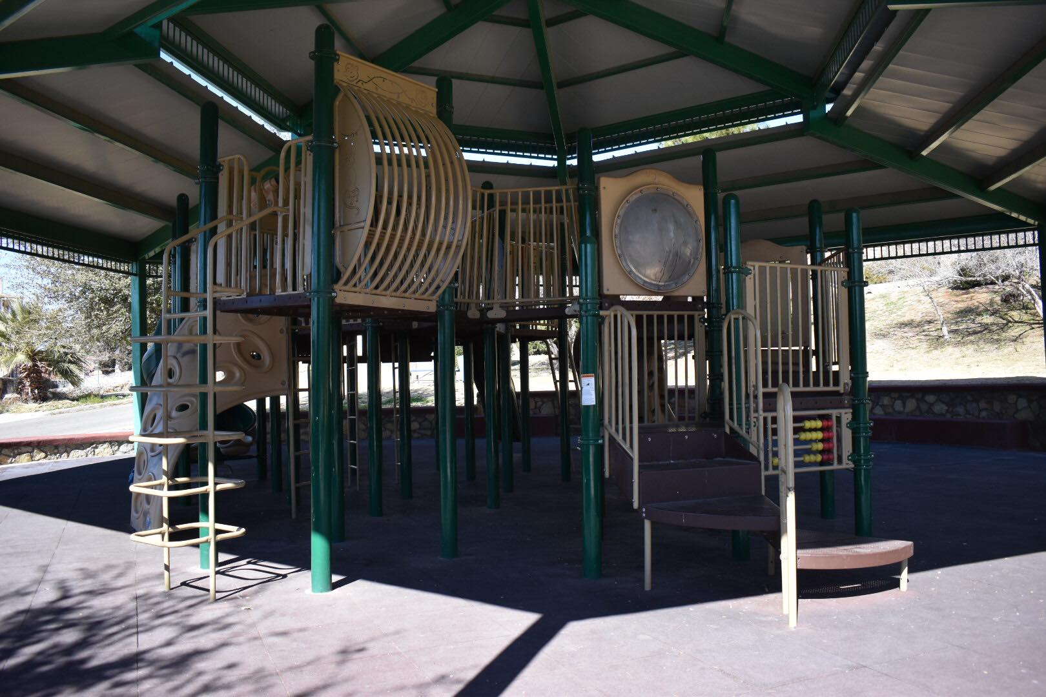
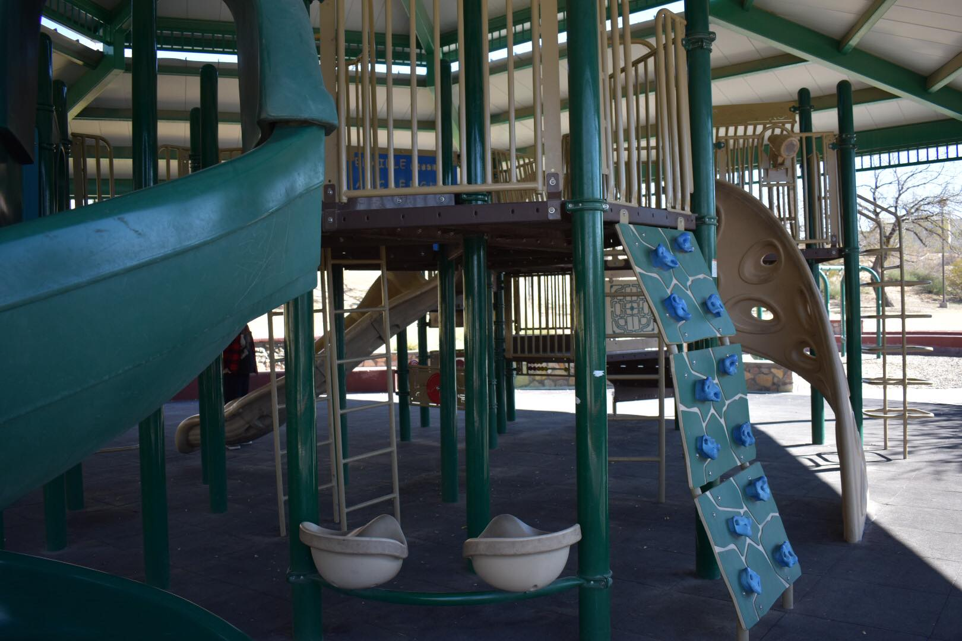
Slide 6
John R. Karr Park
699 Stewart Ct, El Paso, TX 79902

Slide 11
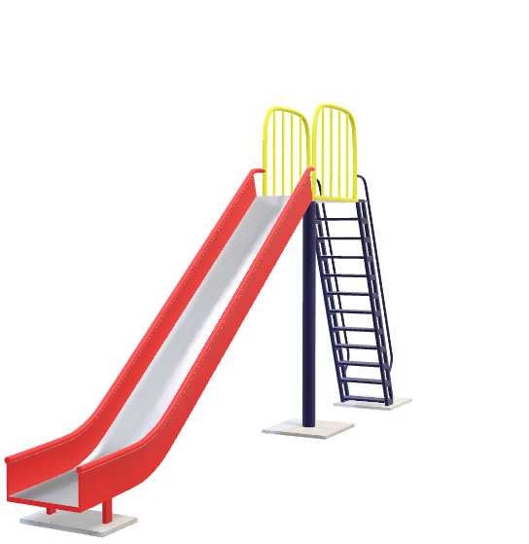
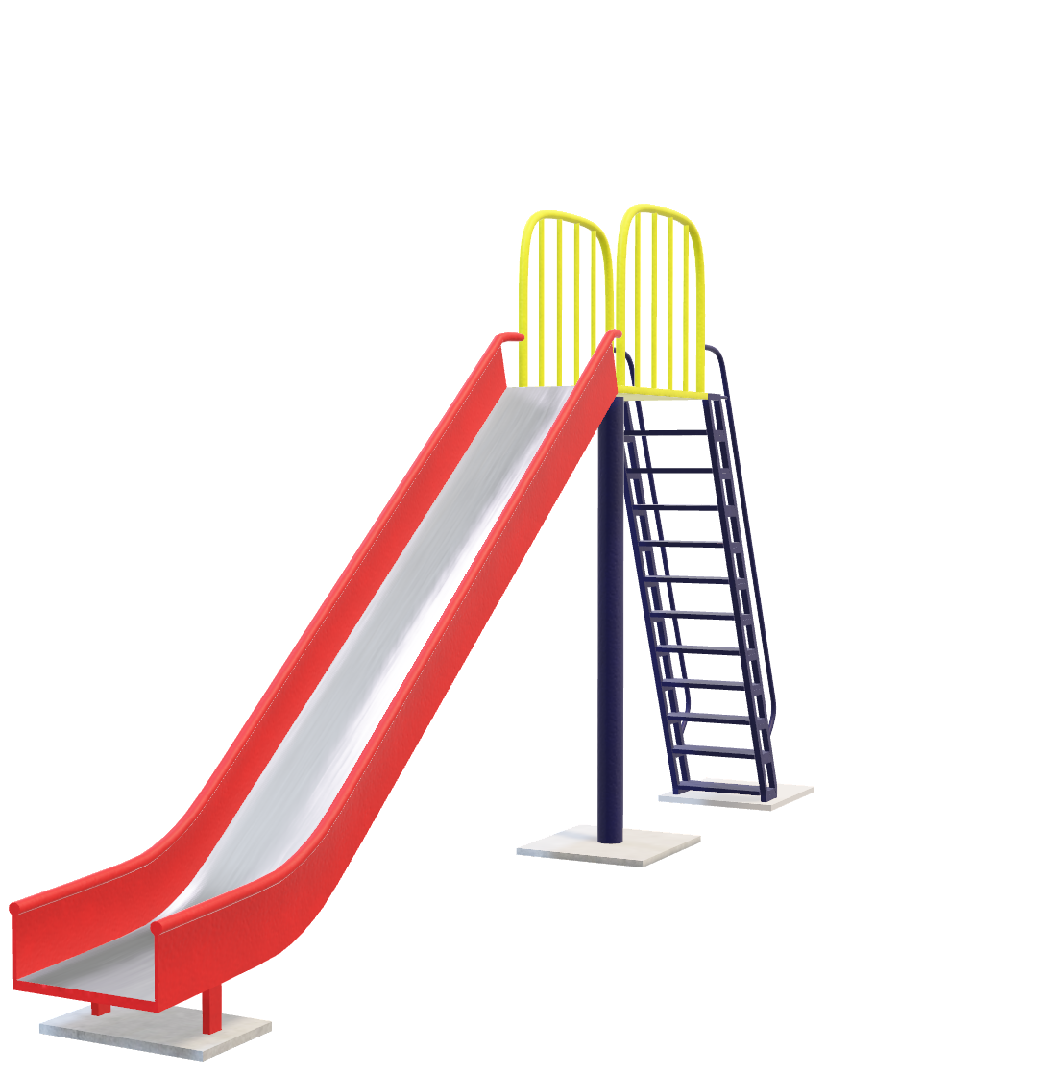


Slide 2
OUR MISSION
My Playground’s mission is to empower children with disabilities to enjoy time with their friends without worrying about what their limitations allows them to do.

Slide 12
Slide 2
OUR BIG IDEA
My Playground’s is a mobile app that anyone will be able to download to look for a park with ADA compliant playgrounds that will fit the necessities of their loved ones.

Slide 13
Slide 8
PHASE 1
MY PLAYGROUND APP

Slide 14
Slide 8
PHASE 2
STATISTICS & STRATEGY

Slide 15
Slide 9
PHASE 3
COMMERCIAL VIABILITY

Slide 16
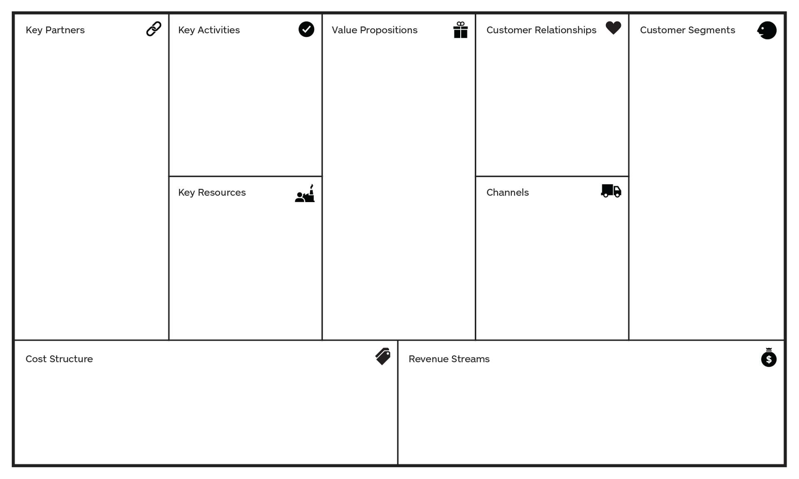
Slide 11
BUSINESS RATIOS

Slide 17

Slide 15
THANK YOU!

